Slide 1
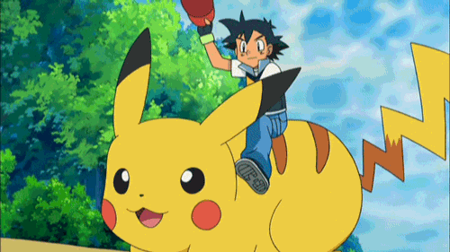
Are you ready?
Let’s learn something new!

Slide 2
Classroom English

Slide 3
Stand up.

Slide 4
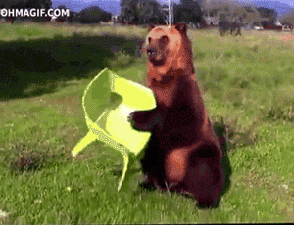
Sit down.

Slide 5
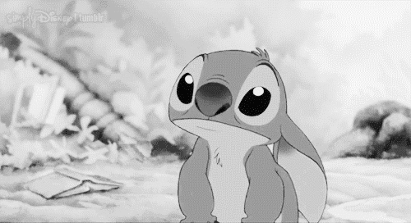
Listen!

Slide 6
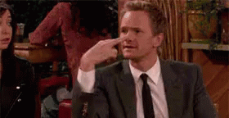
Look at me.

Slide 7
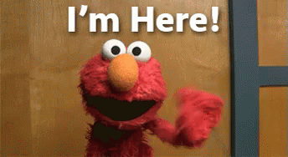
Here.
Elmo?

Slide 8
Attention!

Slide 9
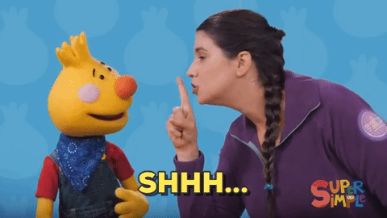
Quiet, please.

Slide 10
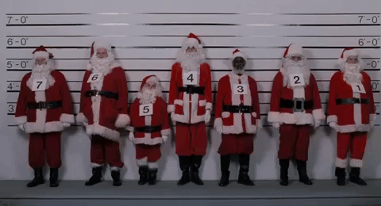
Line up.

Slide 13
Hello! I’m Owen.

Slide 14
Hi! My name is Danny.

Slide 15
Good morning! I’m Irene.

Slide 16
Hello, everybody! I’m Niki.

Slide 17
And me! My name is Dino.

Slide 18
【第一週英語作業】
1. 聆聽和跟讀英語CD1 第2~5首，
每首聽+跟讀3遍可請家長簽名
2.完成英語習作P45~P46，禮拜一交。

Slide 20
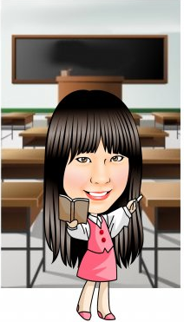
跟著Teacher Mandy一起做字母健身操

Slide 21
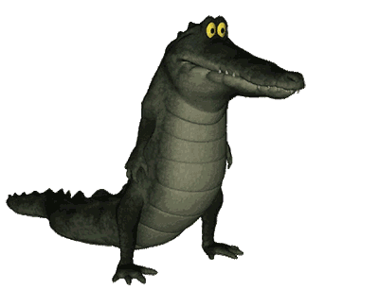
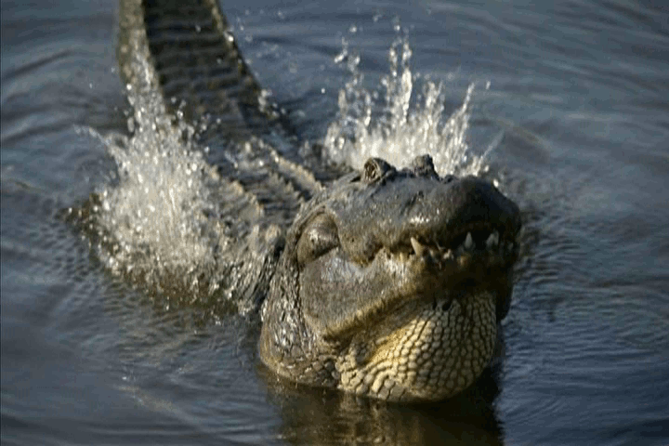
AA aa alligator alligator

Slide 22
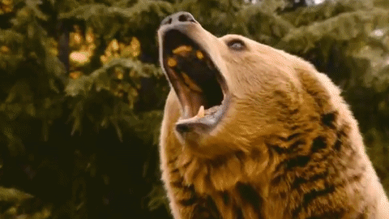
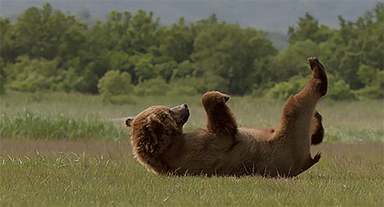
BB bb brown bear brown bear

Slide 23
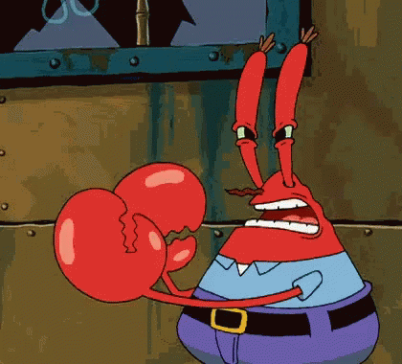
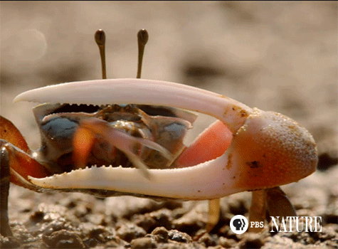
CC cc crab crab

Slide 24
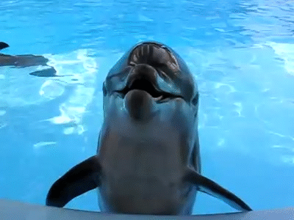
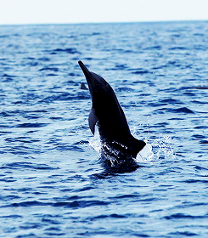
DD dd dolphin dolphin

Slide 25
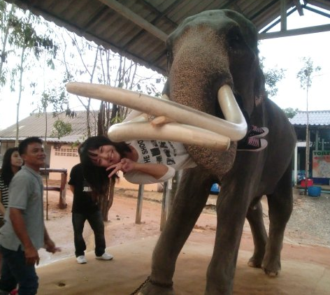
EE ee elephant elephant

Slide 26
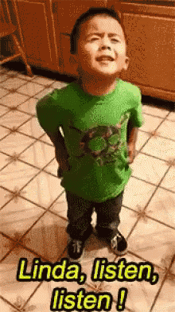
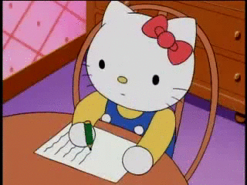
Mission: Listen / Write / Action

